Slide 1
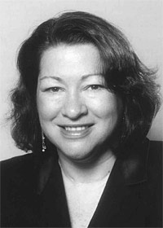
Judge Sonia Sotomayor
Who is she?

Slide 2
A Quote from Judge Sonia Sotomayor's 2001 address to the 'Raising the Bar' symposium at the UC Berkeley School of Law
“ I would hope that a wise Latina woman with the richness of her experiences would more often than not reach a better conclusion than a white male…”

Slide 3
Judge Sonia Sotomayor's 2001 address to the 'Raising the Bar' symposium at the UC Berkeley School of Law (IN CONTEXT)
Whether born from experience or inherent physiological or cultural differences, a possibility I abhor less or discount less than my colleague Judge Cedarbaum, our gender and national origins may and will make a difference in our judging. Justice O'Connor has often been cited as saying that a wise old man and wise old woman will reach the same conclusion in deciding cases. I am not so sure Justice O'Connor is the author of that line since Professor Resnik attributes that line to Supreme Court Justice Coyle. I am also not so sure that I agree with the statement. First, as Professor Martha Minnow has noted, there can never be a universal definition of wise. Second, I would hope that a wise Latina woman with the richness of her experiences would more often than not reach a better conclusion than a white male who hasn't lived that life.
Let us not forget that wise men like Oliver Wendell Holmes and Justice Cardozo voted on cases which upheld both sex and race discrimination in our society. Until 1972, no Supreme Court case ever upheld the claim of a woman in a gender discrimination case. I, like Professor Carter, believe that we should not be so myopic as to believe that others of different experiences or backgrounds are incapable of understanding the values and needs of people from a different group. Many are so capable. As Judge Cedarbaum pointed out to me, nine white men on the Supreme Court in the past have done so on many occasions and on many issues including Brown.

Slide 4
Media coverage
http://rawstory.com/rawreplay/?p=3544
http://mediamatters.org/research/200905260050

